Slide 1
JS Modularization
- The Restaurant approach -
Notes:
Here’s a story for my restaurant approach
From both developer and client persepctive I am going to present it with a Restaurant approach

Slide 2
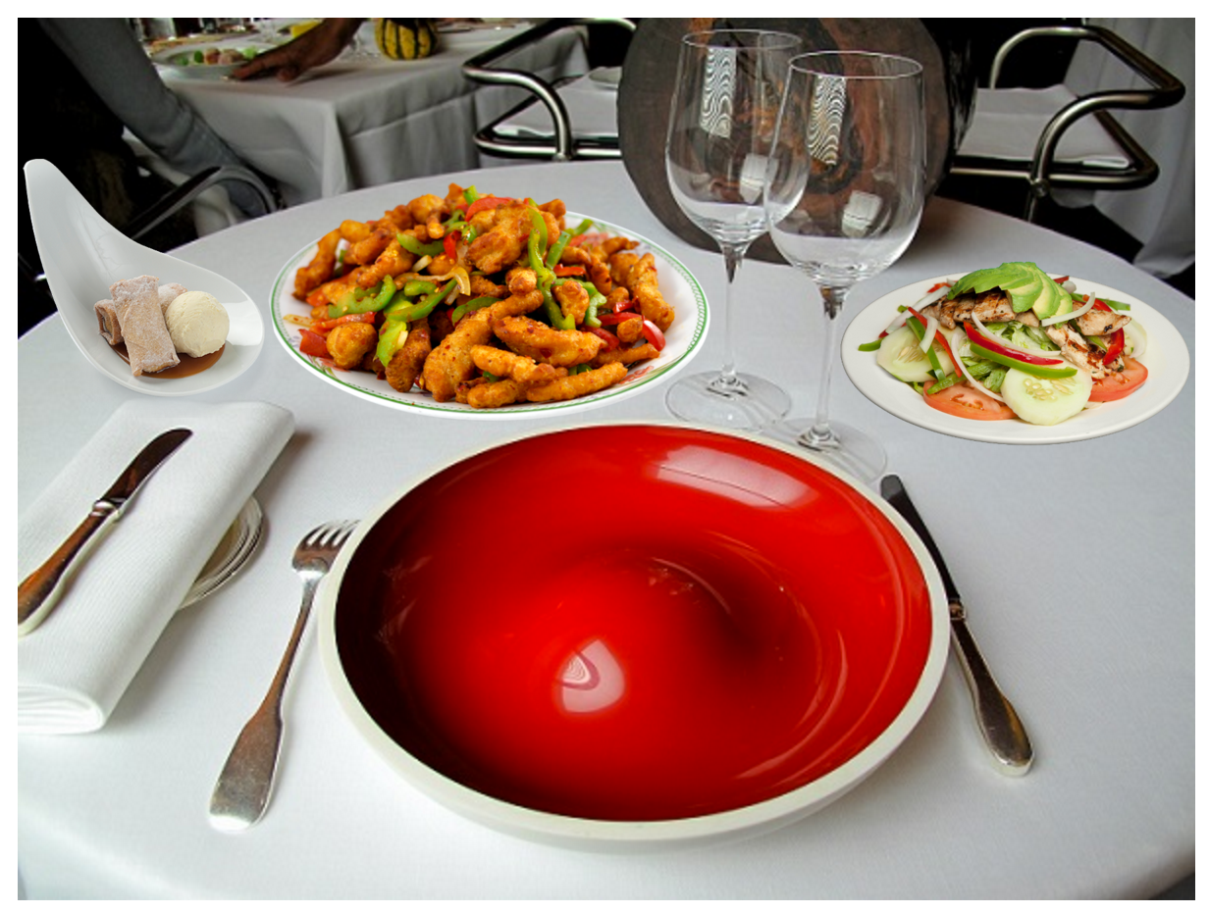
Modularization
Restaurant approach
A Customer (Client) orders a meal
Waiter Vasko (PM) takes the order
Chef Me (Developer) prepares the meal
Decorator Jakov (Designer)
make it look beautiful
Cvetanka (Tester) tastes the meal
At the end Vasko serves the meal
Notes:
parallel with software dev process and restaurant
2 scenarios:
first time ok
second time modifications
and the Chef have problem, but they deliver again

Slide 3
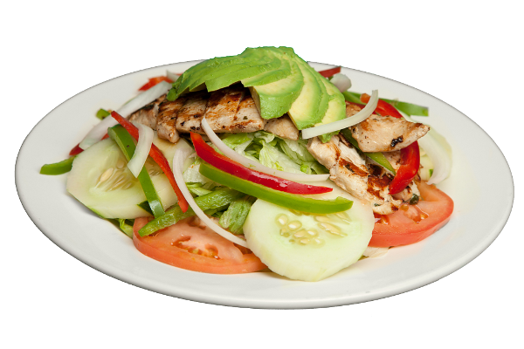
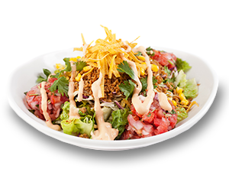
Modularization
Problem – client requirements
Client app extension
3 different countries / versions
Need different style
Need different set of features
Add new features
Change old ones
Most of them same / reused
Do it in 2 weeks :)
Notes:
After we delivered monolith app, the client asked us to suggest solution with minimal changes for more flexible app

Slide 4
How we did it initially
COPY PASTE THE APP
DELETEEEEEEEEEEEEE THE CODE THAT WAS NOT NEEDED
RE-DESIGN THE APP
DEMO:
Restaurant javaDay2014
The story of two students with same task
Notes:
Focus on showing how the app looks like:
what we need to delete
Kope:
After we delivered monolith meal, the client wanted similar app with only few req

Slide 5
Modularization
Agenda
Problems / Motivation
Monolithic V.S. Modularized Apps
How to implement modularization?
Module Identification
Business V.S. Common modules
Refactoring
Build Scripts
Module distribution
Obstacles
Benefits
Notes:
Goran:
So we described the problems with this approach,
And our goal in the next half an hour will be to offer and idea how to handle situattions like

Slide 6
Modularization
Problem – our goals (R&D team)
Reuse the code | Other orders can have same starter?
Ease maintenance | Not all of us want chicken with curry
Testing | Ingredient can be tasted, but also the meal
Extensibility / new features | Client can order multiple meals
Increase development speed | Recipes how to prepare meals
Do it less than 2 weeks :) Solution is simple: Use Modules! But how?
Notes:
Stole
one of the student will be always faster then the other student
The idea for solution came very quick. To use modules but how

Slide 7
Modularization
Monolith Apps
what is monolith app?
is angular monolith?
but wait, there are modules…
hmm, how to use them,
what is module, or what should be?
yet they are not distributed
Notes:
But we go deeper in modularization lets see what is the problem with the current design
Initially the structure that google was providing was a pure monolith app

Slide 8
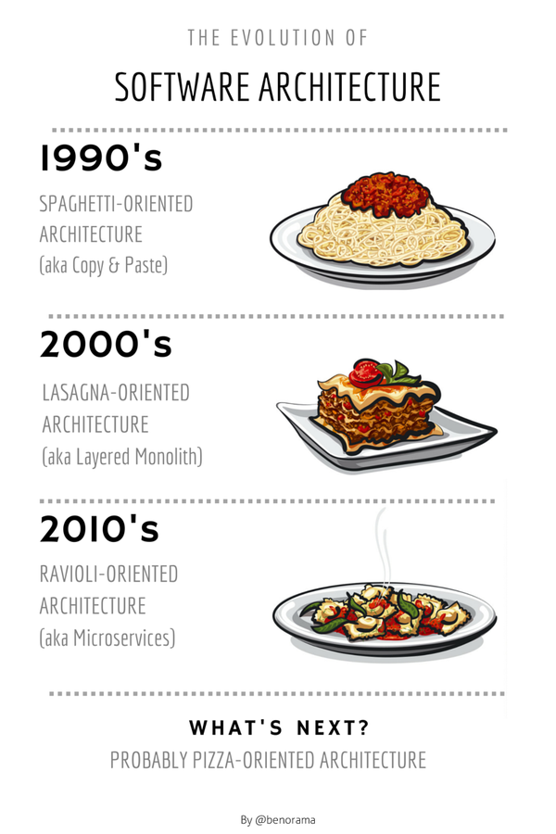
Notes:
2000 pretty much the same (to get to the bottom of lasagna you needed to take a lot of ceremonies until you get the bottom of it).
//Joe Armstrong, creator of Erlang, on software reusability. You wanted a banana but what you got was a gorilla holding the banana and the entire jungle.

Slide 9
Modularization
Benefits of using modules
Distributed / independent development
Code reusability
Program readability / quality
Encapsulation (module is a function)
Manageable tasks
design, implement and test
Notes:
Module can be defined as a piece of independent functionality that work of their own but also can be combined with other modules to create something.

Slide 10
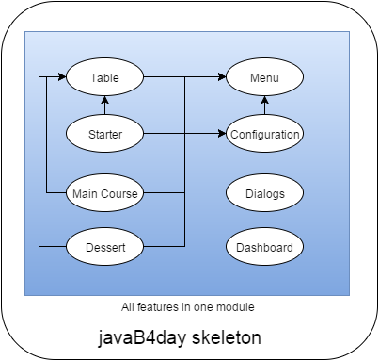
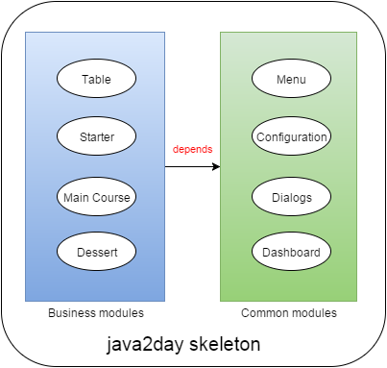
Modularization
Actual V.S. Expected
Notes:
Promeni ime vo javaDay2014
javaSkop2015 skeleton

Slide 11
Modularization
How to do it
Think a lot
R&D, evaluation of existing solutions
Yeoman
ng-boilerplate
npm / bower / grunt /
Distribution
Git
Bower
requireJS
Notes:
OK, so now we know what is modualrization, what are the benefits so now the questions is what tools do we need:
regardless if you are using angularJS ther are multiple solutions that if they are combined correctly, they will give us modularization…
Goran:
How to refactor service, controller CSS, HTML
Different distribution
CHANGE IT!!

Slide 12
Modularization
How to do it
Define our meaning of module
business v.s. common modules
Work in parallel:
grouping / refactoring business code (top down approach)
grouping / refactoring common code (bottom up)
while r&d: build scripts, module distribution, etc.
Notes:
Module identification, what we want to achieve
Different than conventional angular approach
How to refactor service, controller CSS, HTML

Slide 13
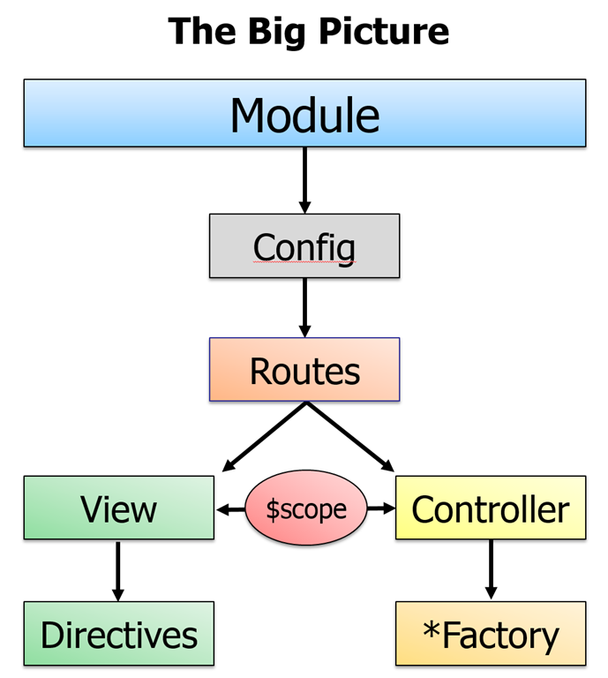
Modularization
Business Modules
Structure
Module definition: config / routes / deps.
Controllers: services, model,
View: html / directives
Other resources: css, images,
examples:
Starter meal
Main dish
Dessert
Notes:
Each config of module will hold the description of the module

Slide 14
Modularization
Common Modules
same structure as business modules
mainly services and providers
html, directives
other resources: css, images
examples:
menu,
dialogs,
data / cache providers,
logger,
i18n
Notes:
Stojan:
Refactoring: Describe the process

Slide 15
Modularization
Build Scripts
Gruntfile.js = task / build manager
bower.json = dependency management
Jshint/esLint = checkstyle and error detection
Karma / Jasmine / protractor = test runner / unit testing / end-2-end testing
Sass / Compass = CSS extension language
One script to rule them all:
build, test, minify, compile a package
We are now CI ready
Notes:
Goran:
Grunt:
automation of the builds
obfuscation of the code
module installation / removal
esLint/jsHint helped alot with the refactoring

Slide 16
Modularization
Demo 2:
Restaurant javaSkop2015
Notes:
Kope:
FOCUS ON:
module provider and config
config json for modules,
dynamic building of app.js
example index.html before and after
example menu
mention SASS,
sample adding and building
skeleton contains the recipe of the app, meals menu
start with table module, explain that it waits for the meals modules
add modules and explain

Slide 17
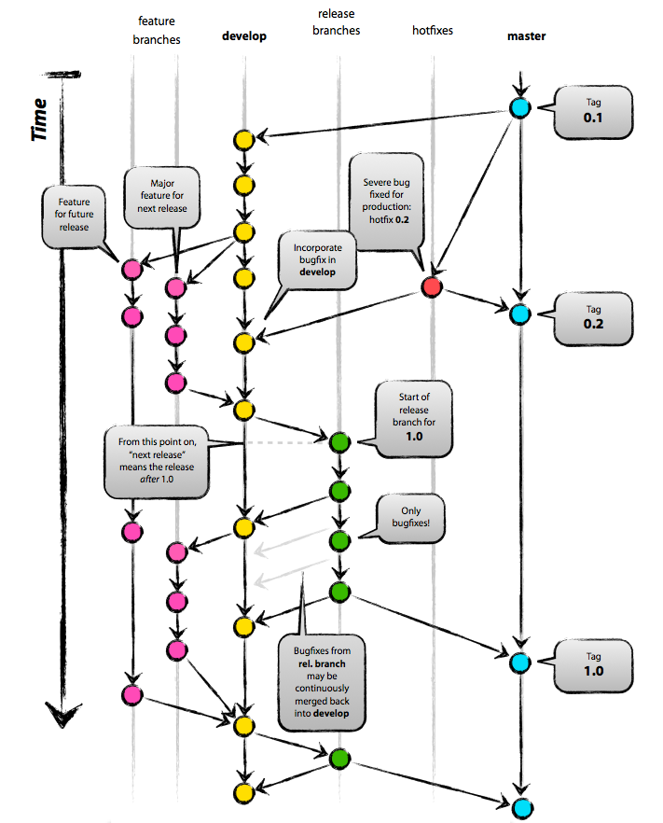
Modularization
New version
javaSkop 1.0
Starter 1.3
Main dish 1.1
Dessert 1.5
javaSkop 2.0
Main dish 1.4
Dessert 2
Notes:
Refactoring: Describe the process

Slide 18
Modularization
Demo 3:
restaurant javaSkop2016
Notes:
Kope:
change version and modules

Slide 19
Modularization
Distribution of modules
not only separate folders, but separate repos / versions
bower modules
node modules
git submodules
Maven-like modules / artifacts
Resulted in 40 modules
6 in this demo
Each repo has its own module definition
Notes:
Stojan
We thinked what we need to do
End result was not to be only folder but separate repo

Slide 20
Modularization
Obstacles
Code everywhere
it’s hard to gain control with a monolithic design
Plug-ability of modules
make them aware of each other using module manager / registration
Generic common features
menu, i18n bundles, configuration, caching, etc.
Notes:
Stojan:
we should refactor module by module, but the time was killin us

Slide 21
Modularization summary
Pros
Increased speed of development
Testable code, less regression bugs
Faster, more secure application (sealed package)
Improved the process of new app creation
Ready for Continuous Integration
Cons
Maintenance of module repositories is more time consuming
New repo, merge, versioning, etc.
Needs a lot of attention when creating a business module
make it independent from other business modules
Notes:
Stojan:

Slide 22
Thank You!
Questions?
Author: Goran Kopevski
gkopevski@gmail.com
@gkopevski
Source code: https://github.com/gkopevski/2015.java2days.base

