Slide 1
Stand Up Comedy Project/Product Management

Slide 2
Site Manager
Aleksandar Ubavkov
https://mk.linkedin.com/in/aubavkov

Slide 3
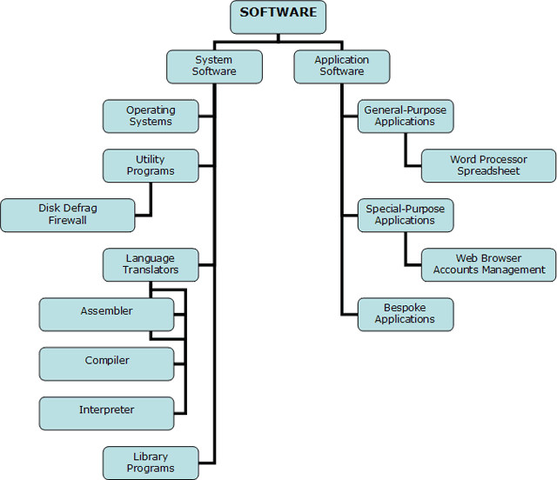
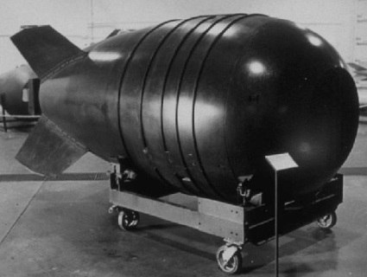
Projects & Products
What is a Project or Product?

Slide 4
Projects & Products
What is a Product?
A Product is anything that can be offered to the market to solve problem or satisfy a want or need.
Why???
What is a Project?
“A temporary endeavor undertaken to produce a unique product, service or result. “
“A project is a problem scheduled for solution”
How???

Slide 5
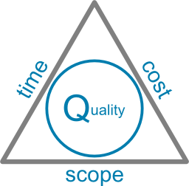
Project Management
Project Management is application of skills, tools, and techniques to achieve project requirements
Definition (Software Project) The set of work activities, both technical and managerial, required to satisfy the terms and conditions of a project agreement.

Slide 6
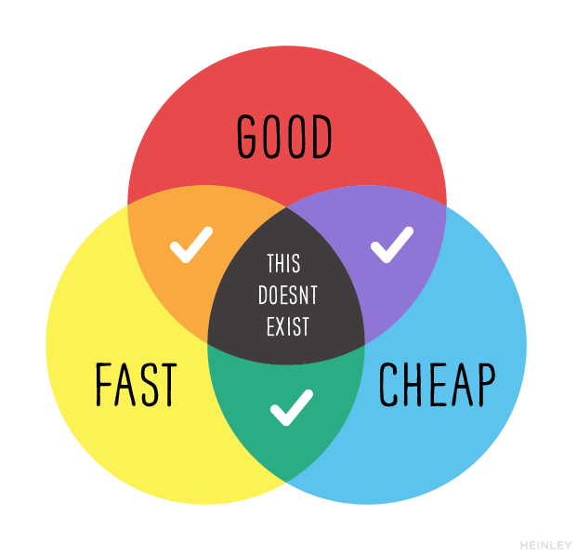
Project Management
Project Management is all about compromise, adaptation and negotiation!

Slide 7
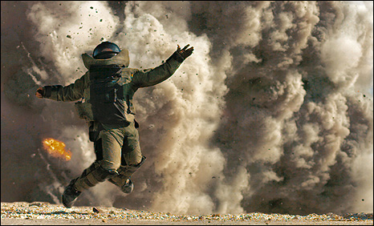
Risk Management
Risk/Opportunity – An uncertain event or condition that, if it occurs, has a positive or negative effect on a project objective!
Risk is defined by PROBABILITY and IMPACT FACTOR

Slide 8
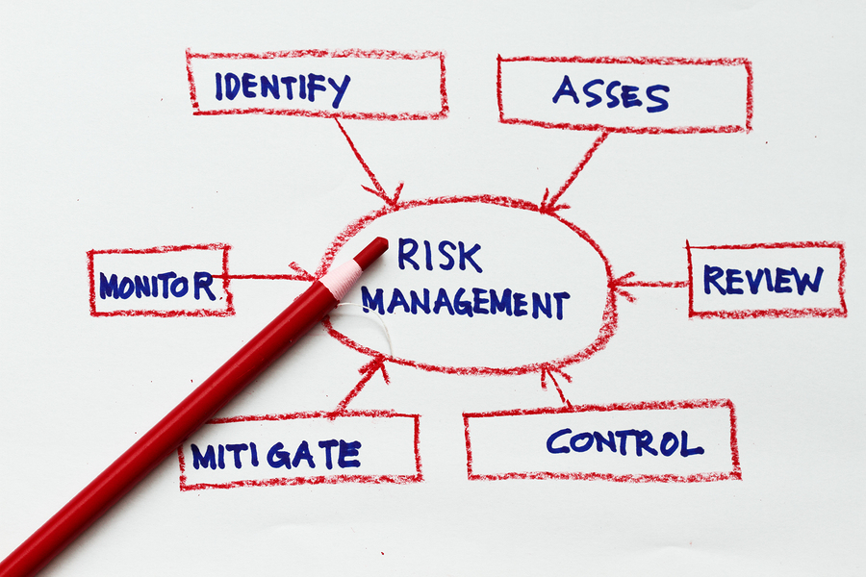
Risk Management

Slide 9
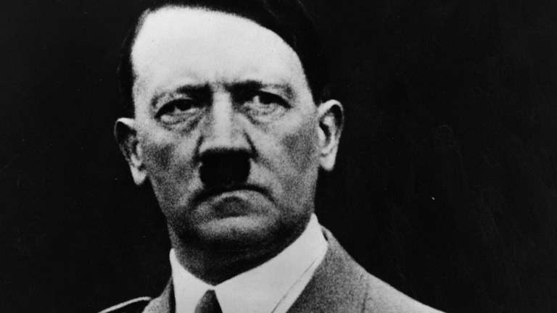
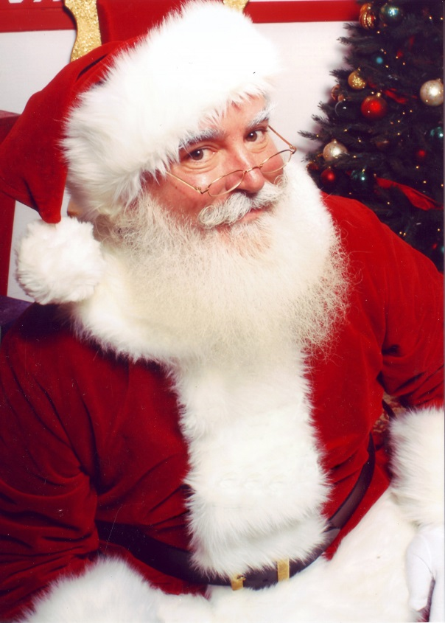
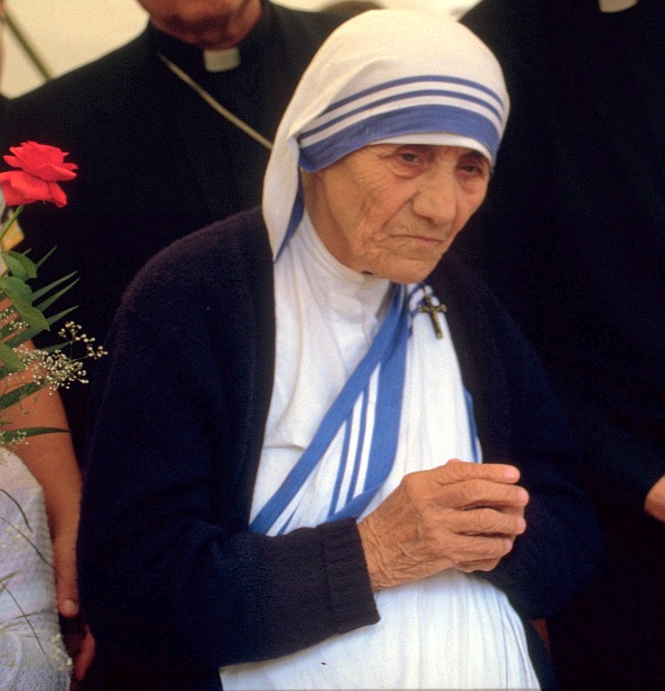
What do these people have in common?

Slide 10
What do these people have in common?

Slide 11
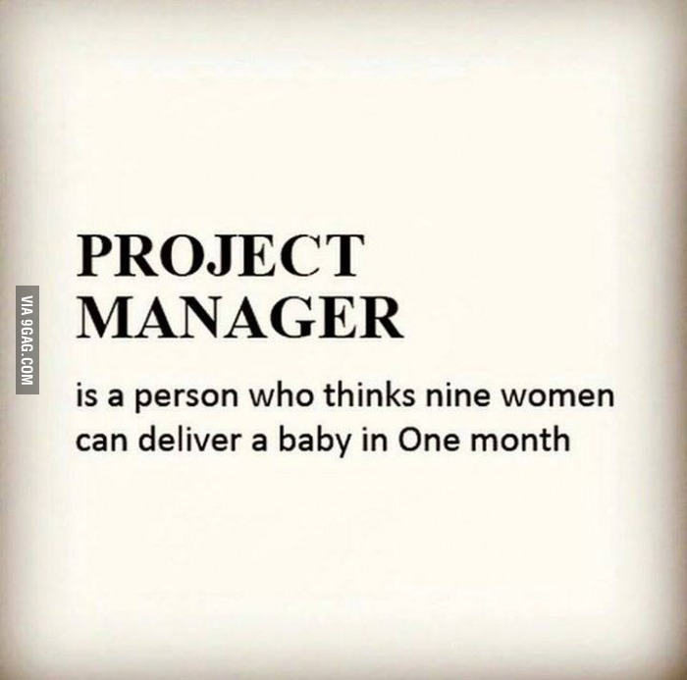
Project Manager
What is Project Manager?
Project Manager is a person whose primary responsibility is to ensure that all work is completed on time, within budget and scope, and at the correct performance level.

Slide 12
Project Manager - skills
Technical abilities
economical know-how
application know-how
software engineering know-how
Project management abilities
planning, estimation, controlling
time management, negotiation abilities
Leadership abilities
communication, decision, delegation
motivation, moderation
Personal abilities
responsibility, toughness, team spirit
patience, ability to communicate, fairness

Slide 13
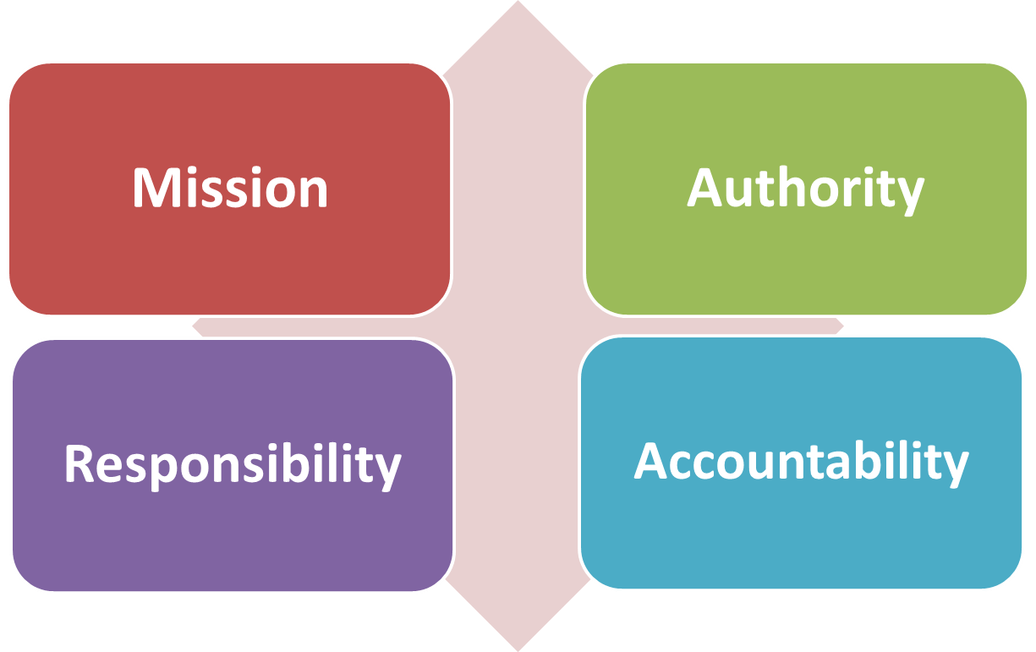
Project Manager Tools
Authority is the power given to a person to complete the assigned responsibility.
The mission is to achieve the vison for the final result
Responsibility is an agreement between two or more people for the purpose of achieving a desired result.
Accountability is a consequence of assigned responsibility.

Slide 14
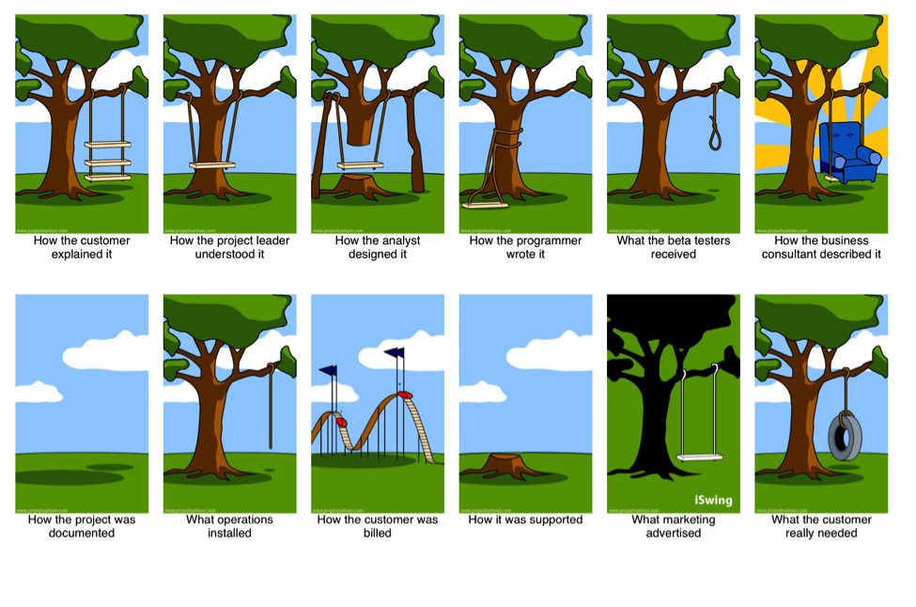
Real Life Software Project

Slide 15
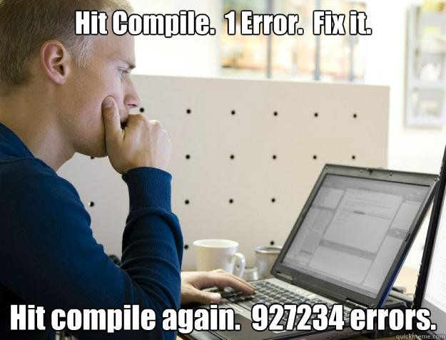
Software Development Processes
Code & Fix
Definition: Coding and error correction together with ad-hoc tests are the only activities performed consciously !
Systems don’t conform to the real requirements
Cost for corrections are disproportionately high
Important concepts and decisions are not documented

Slide 16
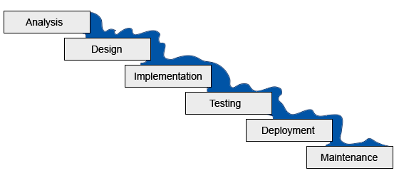
Software Development Processes
Waterfall - Water-”fail”
Waterfall Model — A model of the software development process in which the constituent activities, typically a concept phase, requirements phase, design phase, implementation phase, test phase, and installation and checkout phase, are performed in that order, possibly with overlap but with little or no iteration.
Works when:
Requirements are known up front before design
Requirements rarely change
Users know what they want, and rarely need visualization
The system is not so complex.
Supports project management!
Supports planning and controlling!

Slide 17
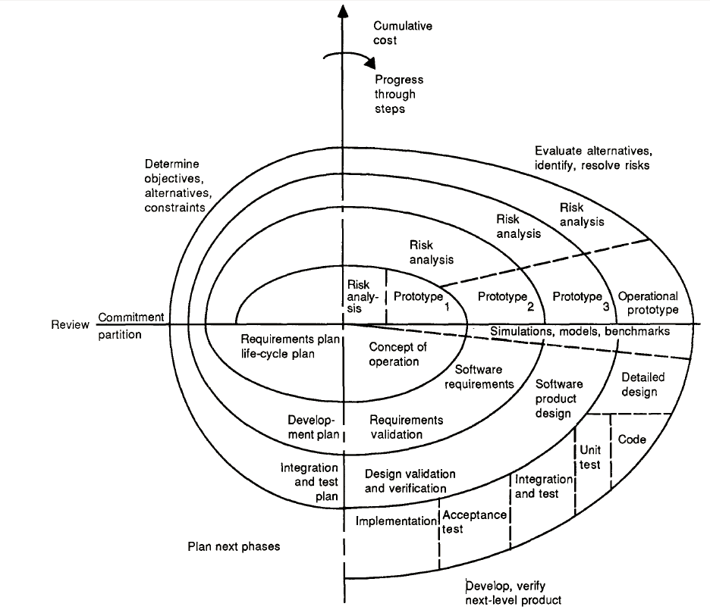
Software Development Processes
Spiral Model
A development model should ensure, that risks are identified and managed as early as possible!

Slide 18
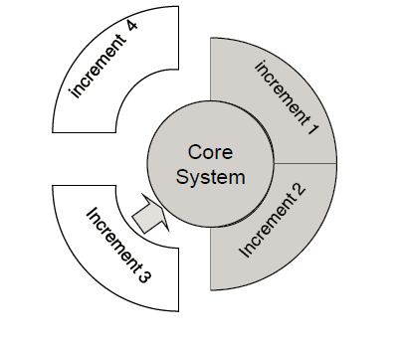
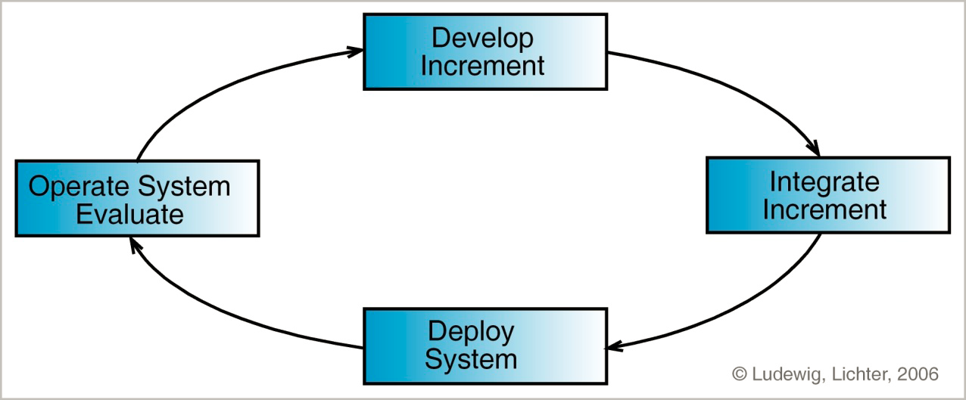
Software Development Processes
Incremental Model
Project progress is shown not by documents but by executable systems
Each increment implements a defined set of requirements
Lesser precision of estimations
Lack of documentation
More suitable for products than services

Slide 19
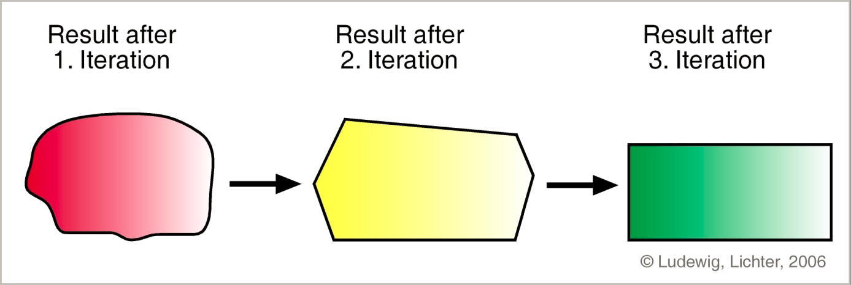
Software Development Processes
Iterative Model
Controlled continuous revision of software aiming at correcting errors early and integrate improvements.
Recognizes the reality of changing requirements
Promotes early risk mitigation
Focuses on component architectures
Lesser precision of estimations
More expensive
More suitable for products than services

Slide 20
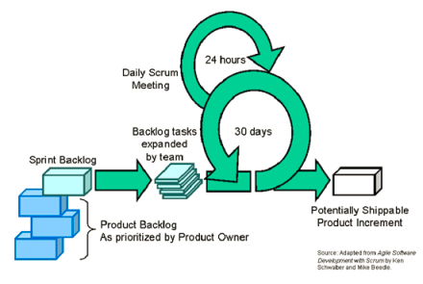
Agile Methodologies
Feature Driven Development

Slide 21
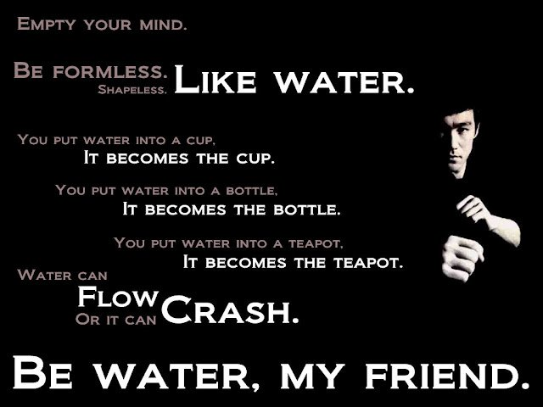
There is no right way
Experiment and find out…
…so you can tell your story!!!

