Slide 1
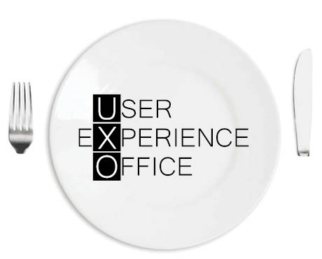
May the UX force be with you
Why you should care about User Experience
JavaSkop – 13 December 2015 – Marcel Kessler – @cheesenoc
Notes:
Hi
Glad to be here
My name is marcel
I m coming from bern, switzerland and got up at 4 in the morning
Talk about ux
Who are you?
Engineers?
Backend?
Frontend?
PLs?
REs/BAs?
UX?

Slide 2
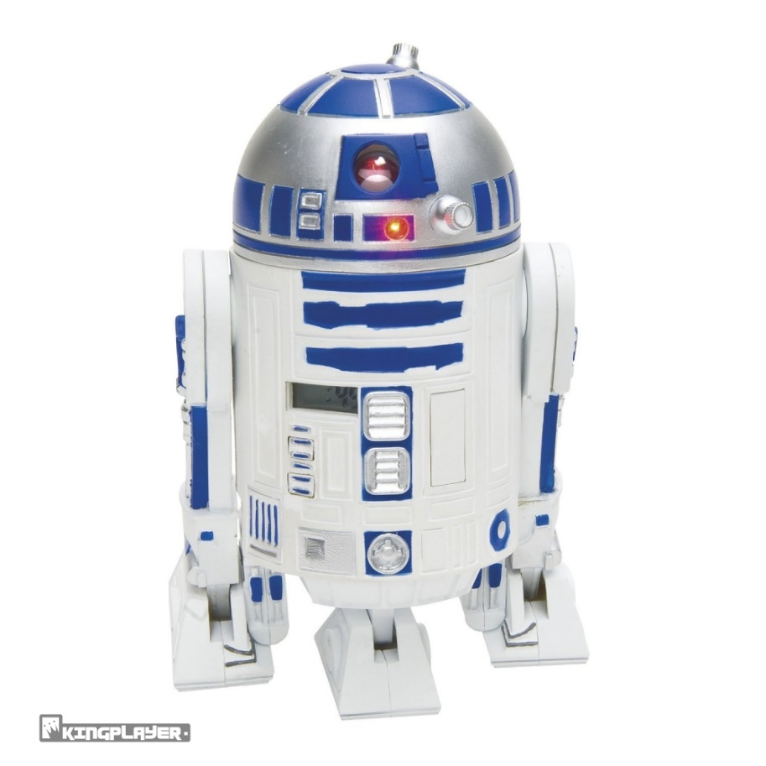
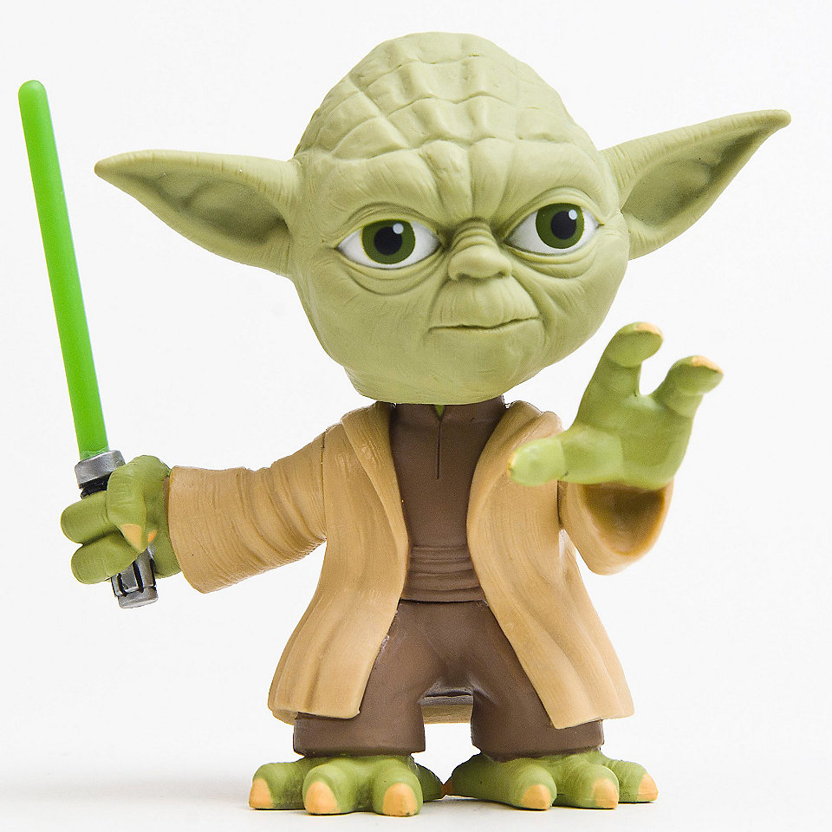
About me
Notes:
Used to be a software engineer, then i studied HCI and got to know the UX force
Head of ux at netcetera

Slide 3
Agenda
What is UX?
Why UX?
What we actually do
User Research, Personas & Scenarios
Sketching & Prototyping
(Live) Styleguide
Usability Testing
Wrap-up
Questions
Notes:
Ca. 30 min, then 15min Q&A
I prefer questions at the end
Last: your stomach

Slide 4
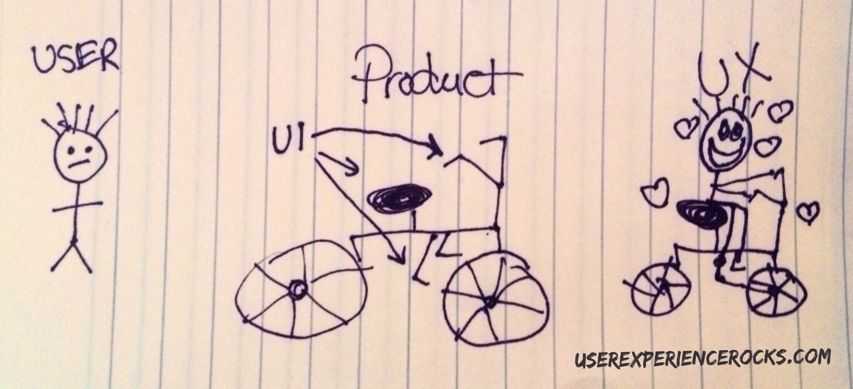
What is UX?
Notes:
Ux is all about the user
Nice bicycle analogy
UX vs UI (user interface)

Slide 5
What is part of UX?
+ Frontend Engineering
Notes:
And in our case also frontend

Slide 6
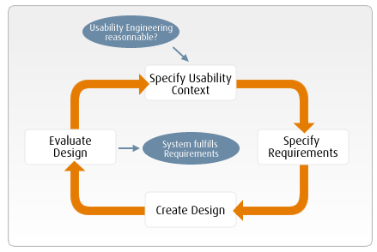
User Centered Design (UCD) – ISO9241-210
Notes:
How to create a good user experience? Focus on the user…
Official process (ISO certified)
4 steps, iterative
Who is using the system and in which context?
What are the users needs and goals?
What desgin fulfills this goal?
Test: Does the design fullfil the goals?

Slide 7
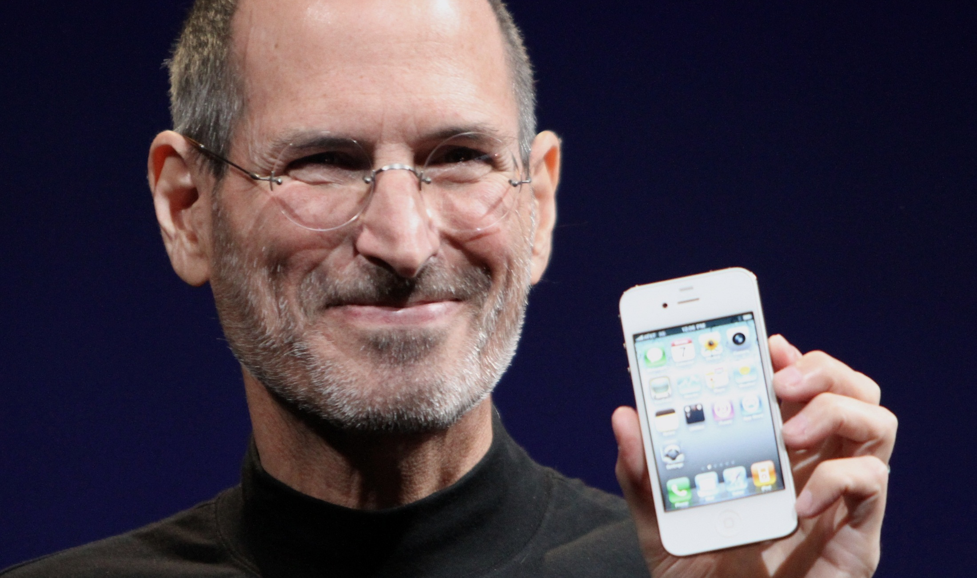
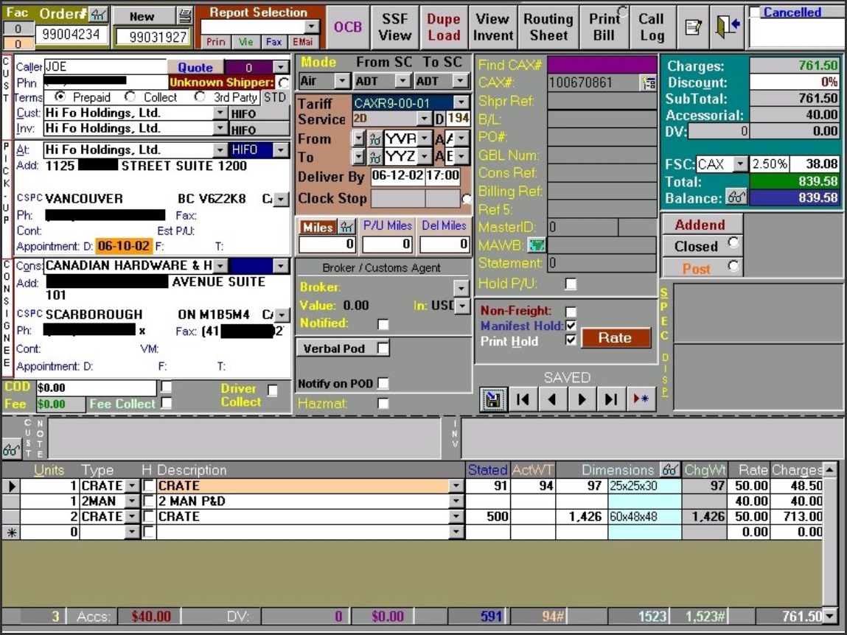
Why UX?
Notes:
but why?
Not just a joke, it s really a bit because of steve…
Generally, all users now expect beautiful and easy to use software, even in business applications…
And not something like this…

Slide 8
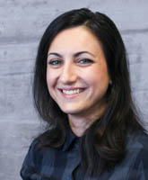
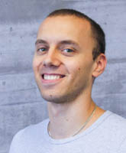
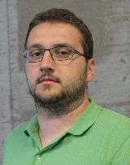
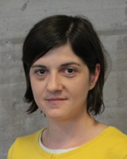
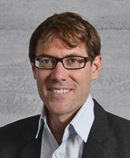
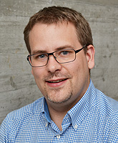
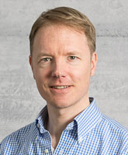
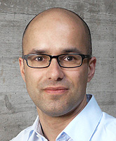
What we actually do – Who is we?
Notes:
At netcetera, the ux team is 5 people in skopje and 5 guys in zrh, mostly engineers, but also psychologists and design backgrounds

Slide 9
User Research
GOOB!
Notes:
As i said, the user is in the center… and where is the user? Usually not in our office -> get out of the building, see how the user works,

Slide 10
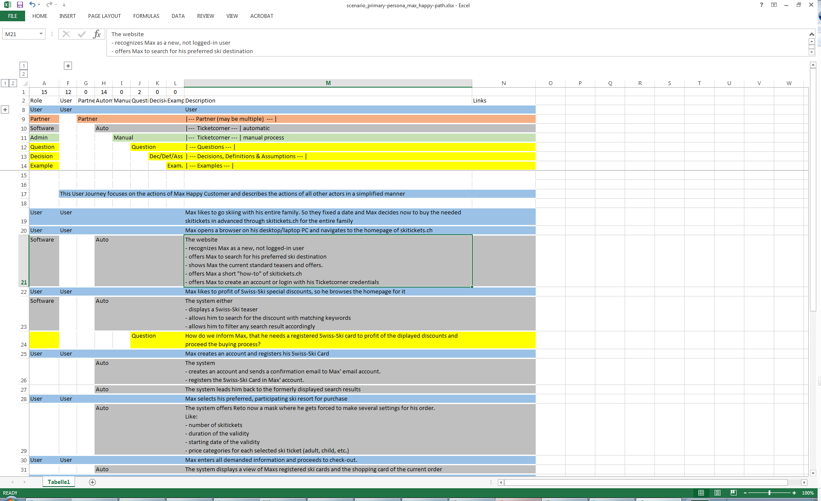
Personas & Scenarios
Notes:
Findings from user research are distilled in something called personas,
Fictional users that represent the target audience, usually including name, photo, goals and description
Based on goals, we create a happy path scenario («perfect» workflow for the user) as base for prototype

Slide 11
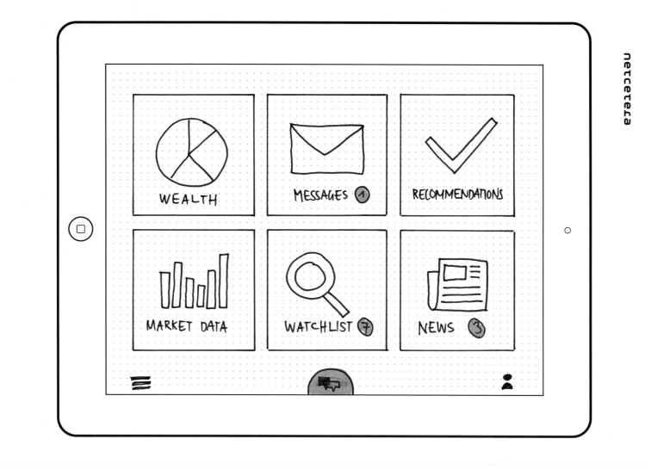
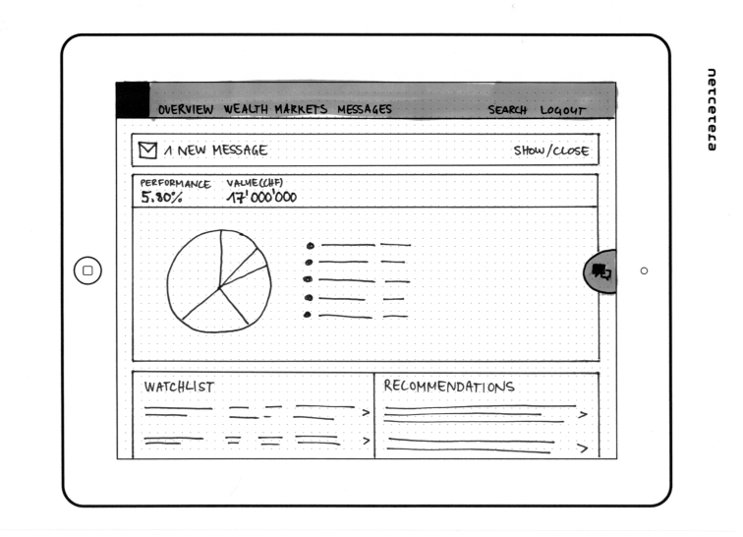
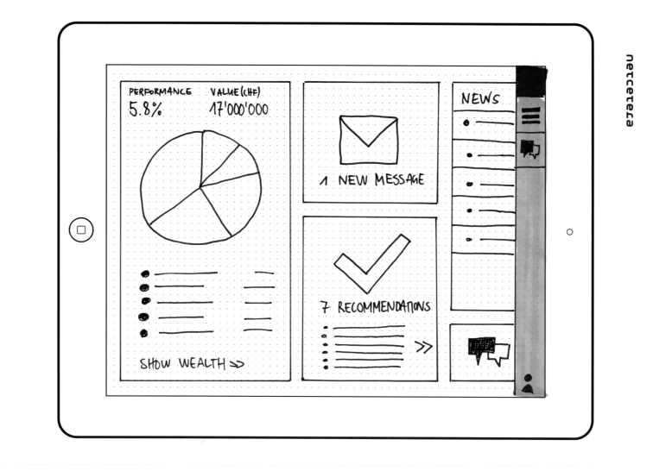
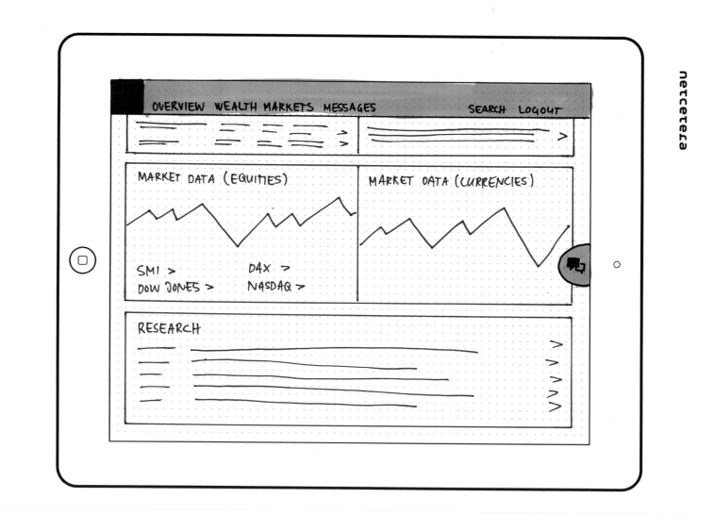
Sketches & Storyboards
1
3
2
4
Notes:
For the interface, we usually do some sketches to find out how it could be and compare the options
Then we sometimes connect those sketches to a storyboard (sorry for the german)
Actually, this works pretty well with e.g. microsoft surface and onenoet

Slide 12
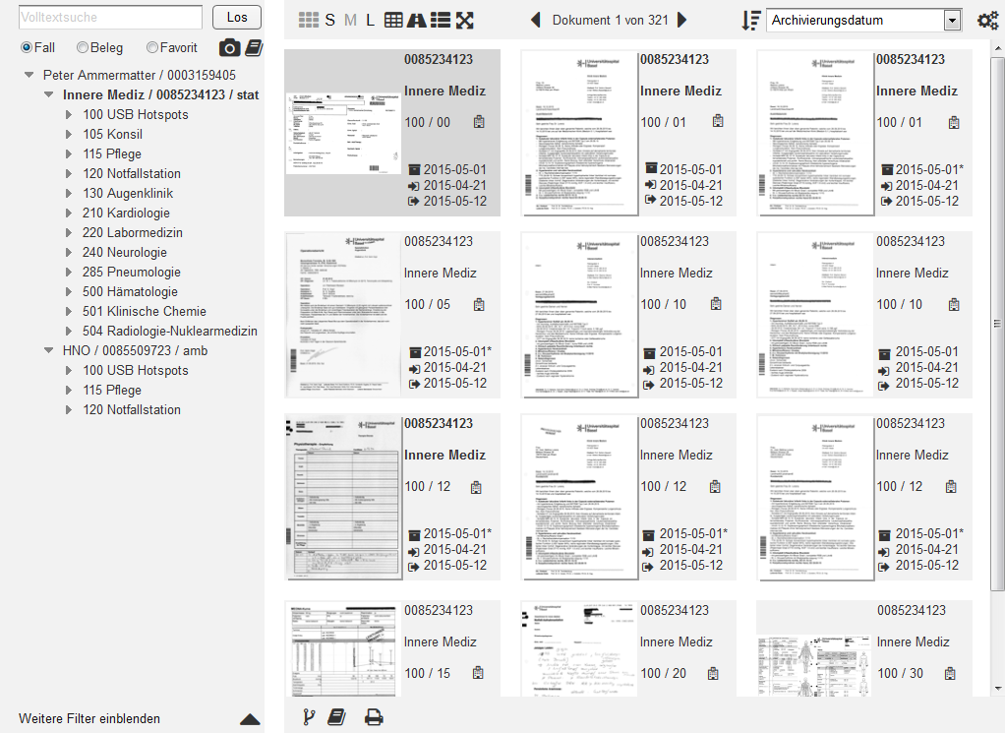
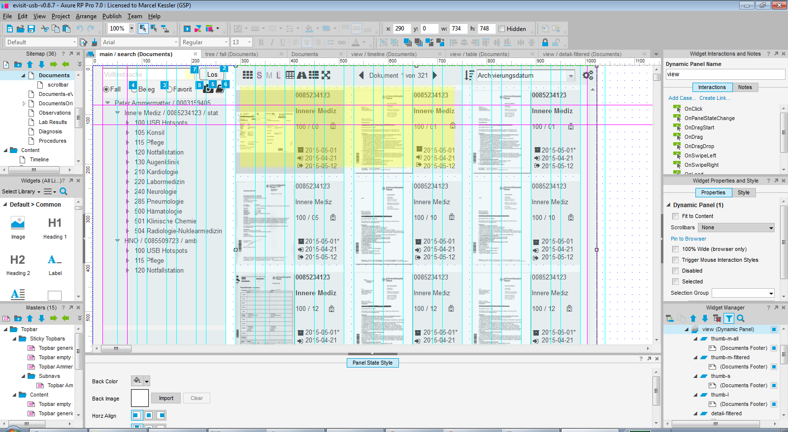
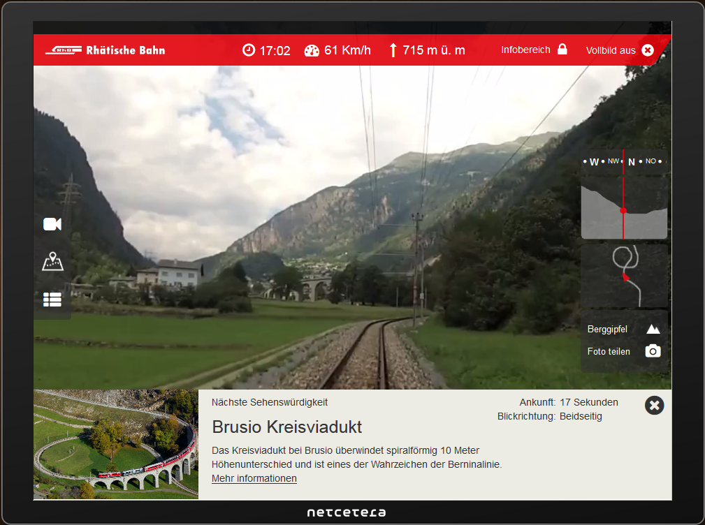
Prototyping
Notes:
Prototyping -> main benefit, prototypes clarifies a lot, helps to focus, tool for communication
Can be balsamiq, is often axure (more interactivity), can be grey wireframe or already quite according to styleguide (railvista), or even done directly in HTML
Short demo of axure, how prototype can be and how it s done
Axure like mix between powerpoint and dreamweaver

Slide 13
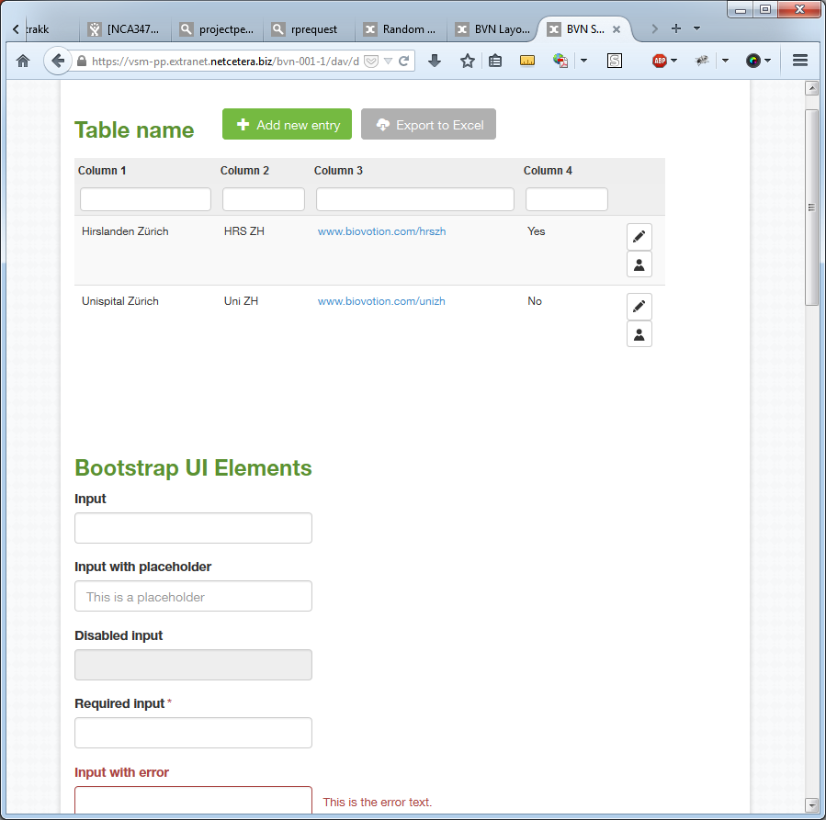
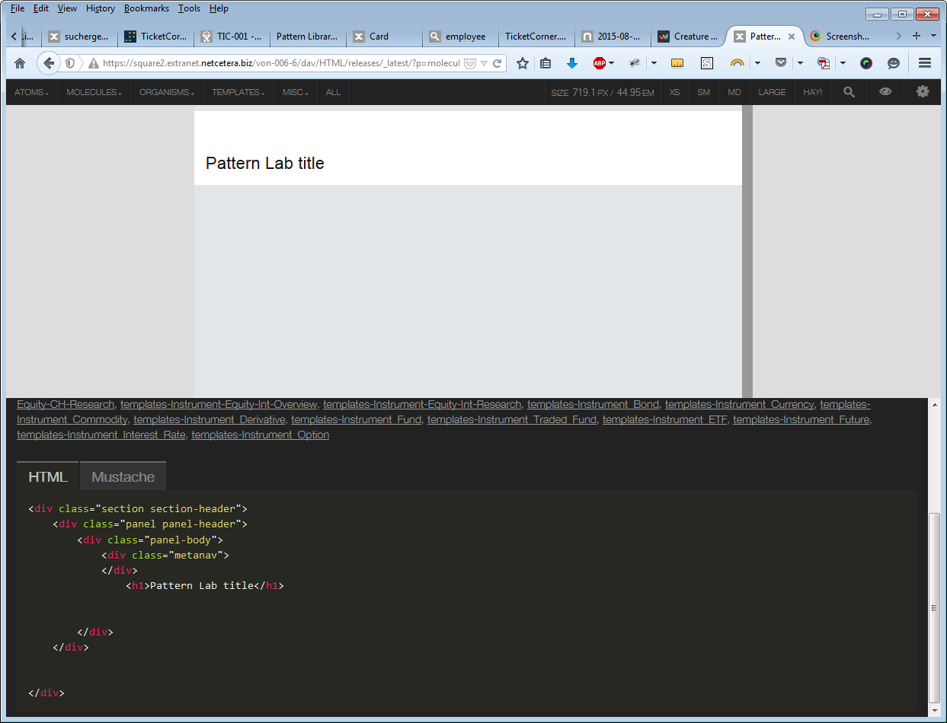
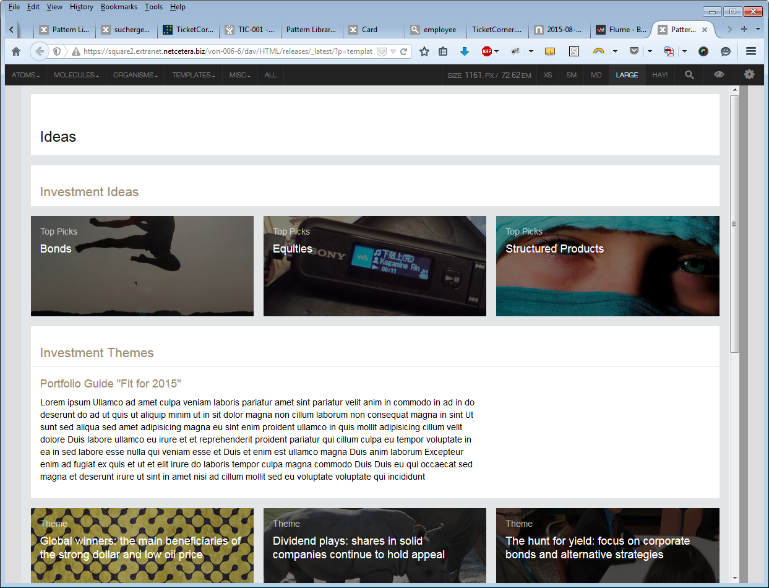
Live Styleguide / Pattern Library
Notes:
FE: separate / standalone styleguide or pattern lib that provides all elements that are needed,
«live» system is using same CSS as styleguide, devs can check which classes to use etc.
Very simple and more complex example, tool patternlab that is quite sophisicated,
atomic design -> modular CSS, demo

Slide 14
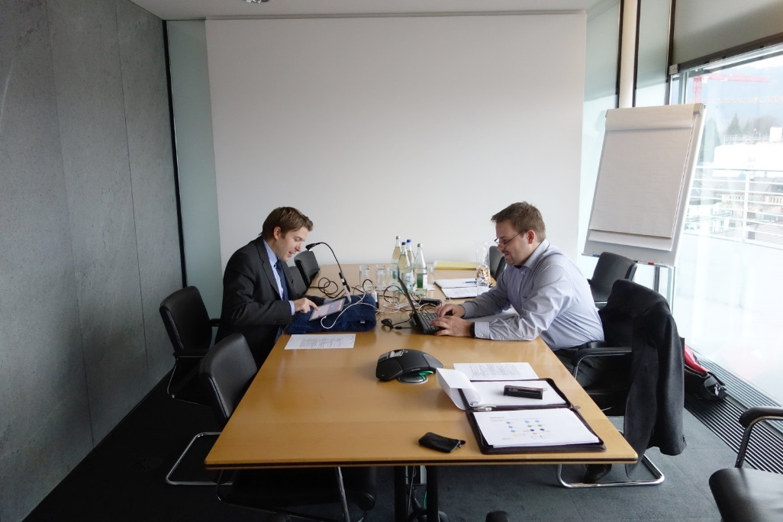
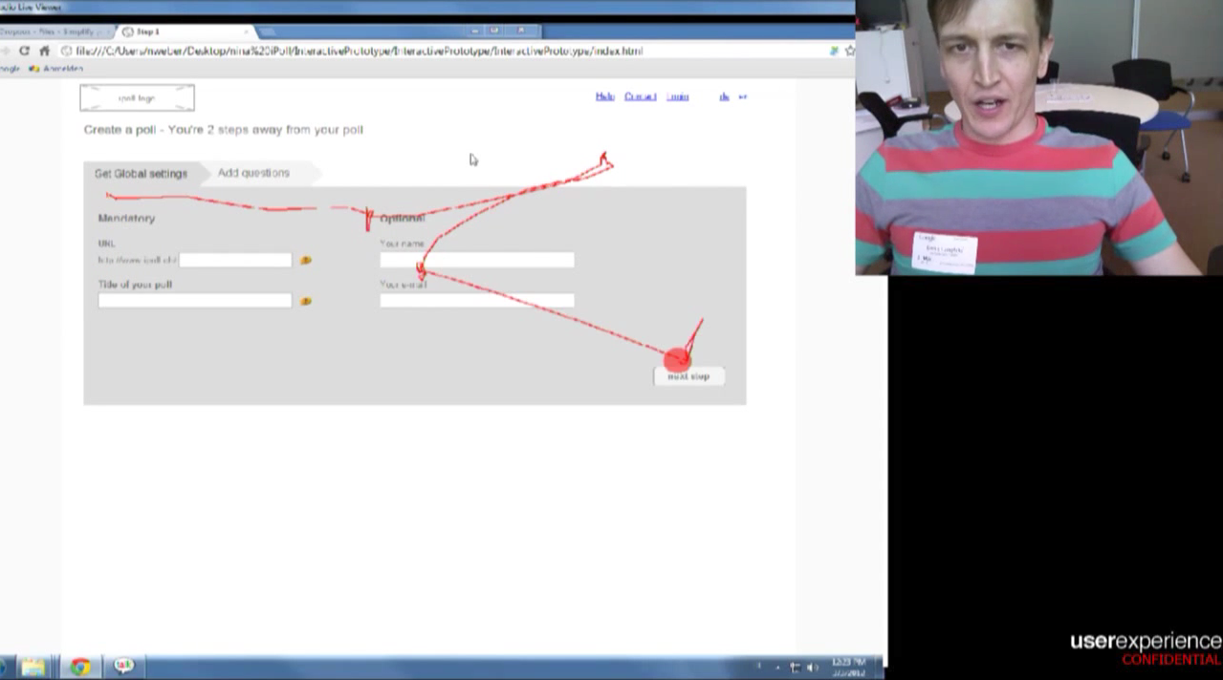
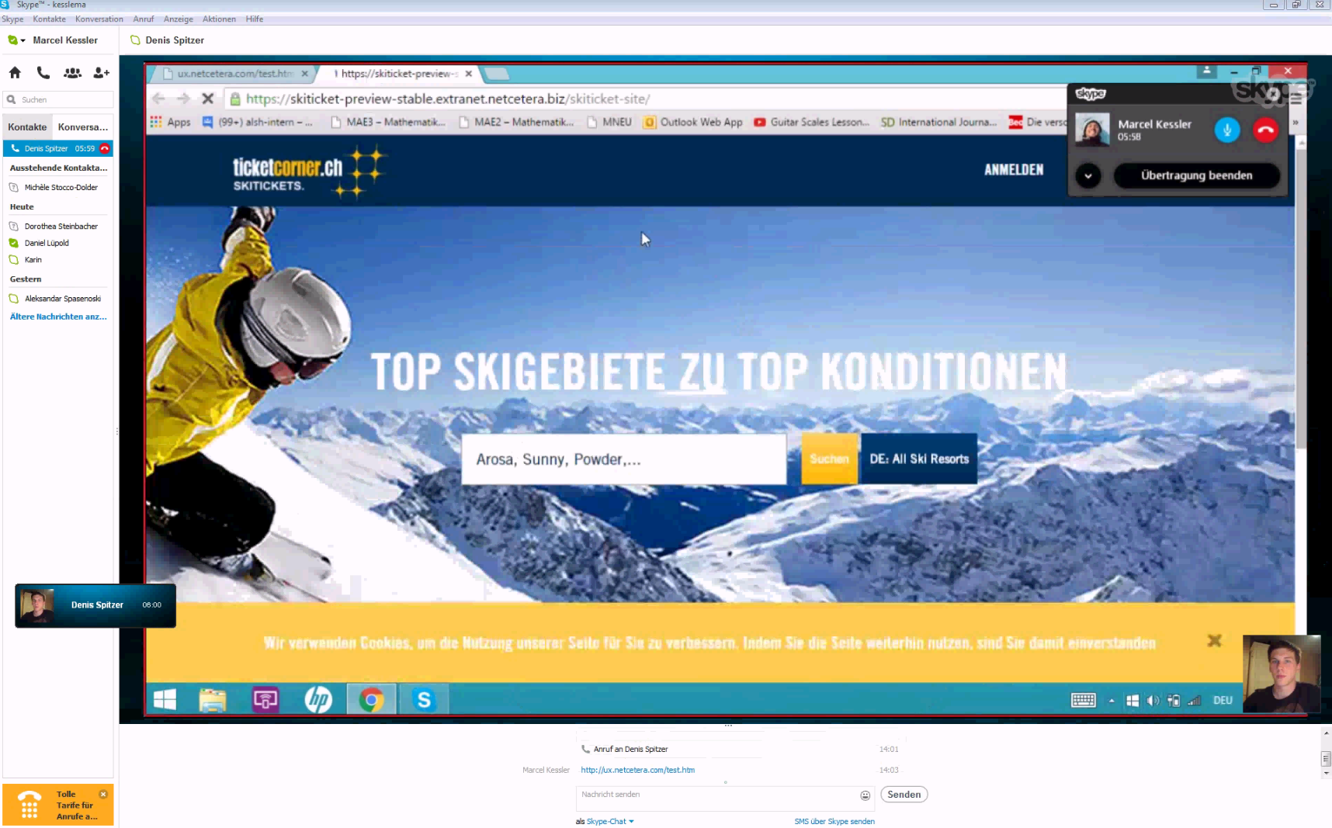
Usability Testing
Notes:
Usability testing -> very helpful, test with real users, ask them to «think aloud»,
based on prototype but also with live system, can be face to face or via skype,
It can even involve eye-tracking, to check what the user actually looking at.
Usually 5 users are enough to find 80% of usability issues

Slide 15
Wrap-up
Notes:
[give time to read]
This is not meant as an insult, and by now you should know that ux is more than just visual, but it is as crucial as e.g. performance or security
The main goald is to focus on the user, all else will follow
There have been not so many star wars references, so here a few more ;-)

Slide 16
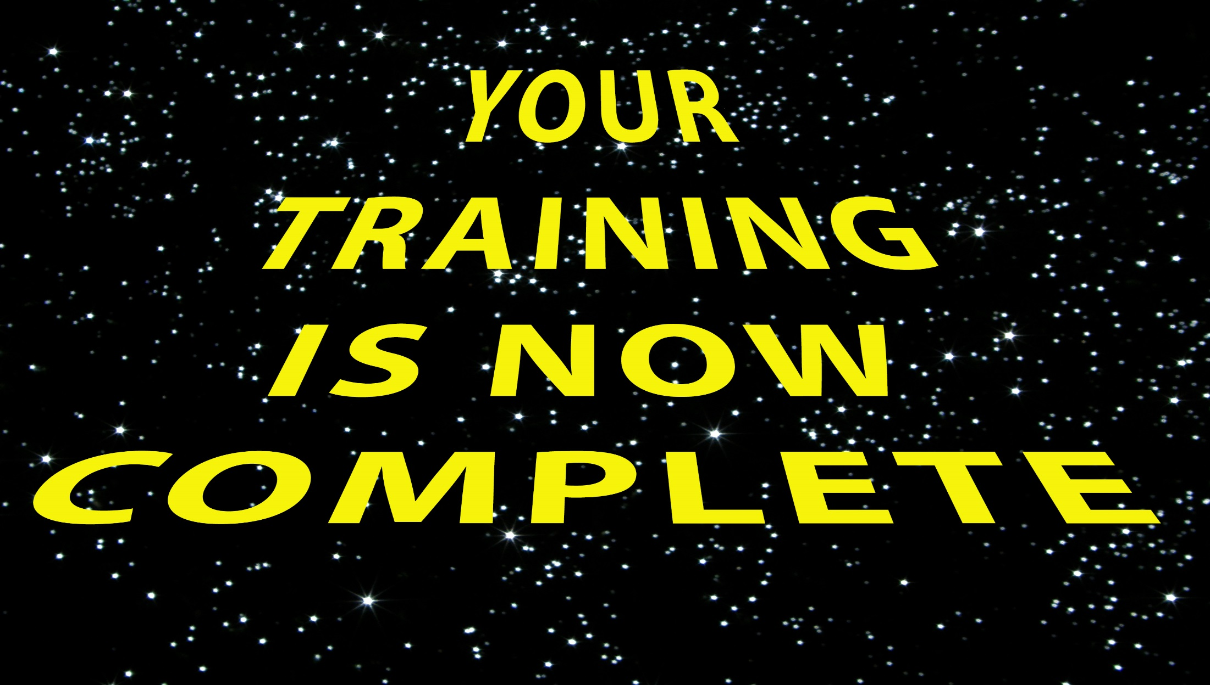

Slide 17
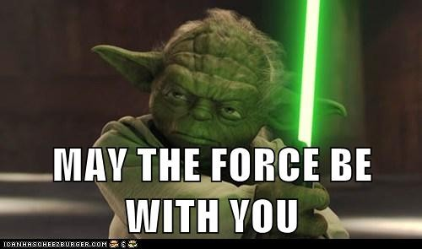
UX

Slide 18
