Slide 1
How to: Register and Login
Marjan Kindalov
Notes:
Hello and welcome
You would expect so see my notes here. But hey!!! I am not that easy guy.
So here is a joke while you are spying on my notes:
How does a train eat?
It goes chew chew.
I have big jokes, the best jokes. Don’t I?

Slide 2
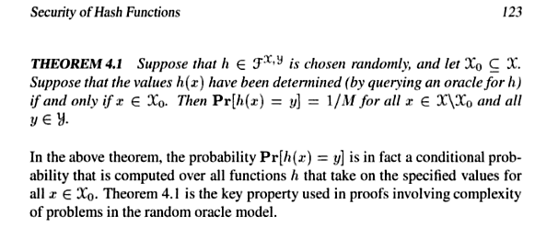
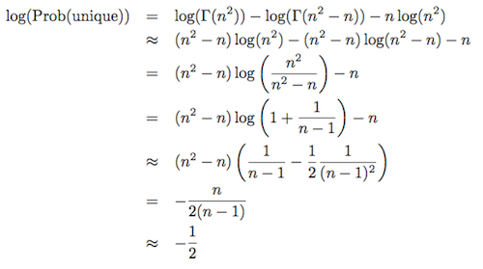
Basics

Slide 3
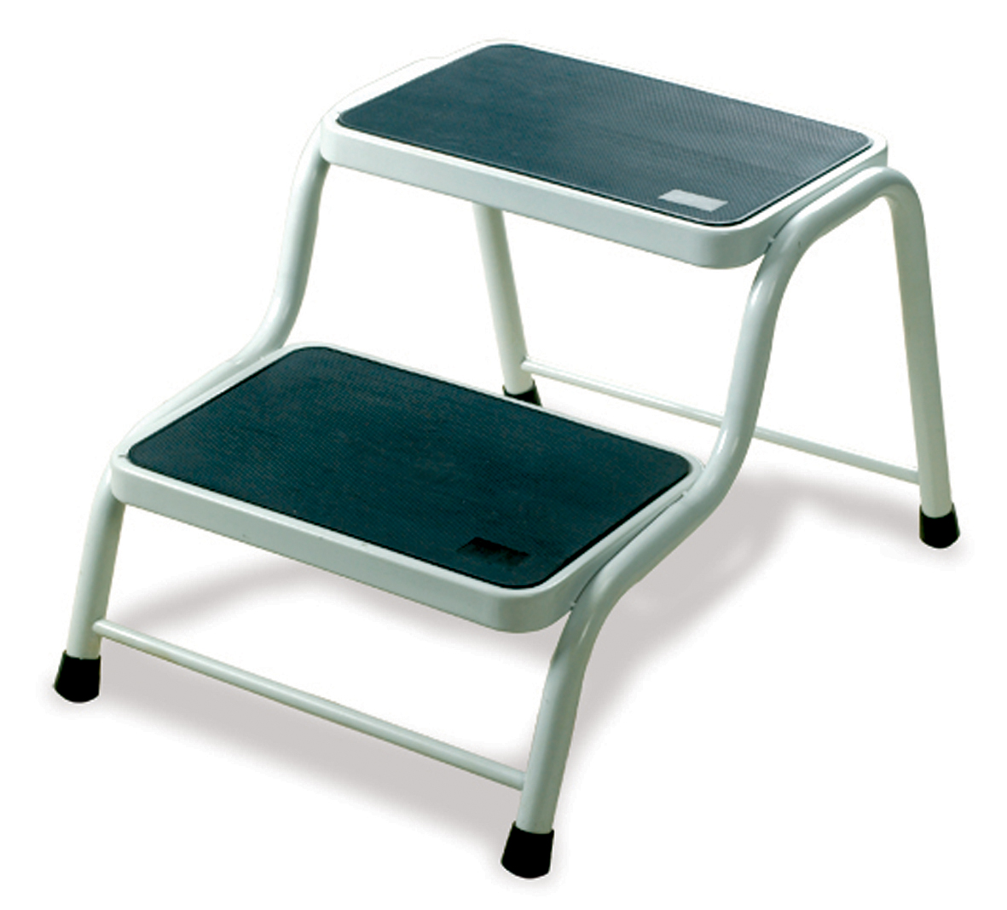
Registration
Notes:
One way for implementing a registration is so called 2 step registration.

Slide 4
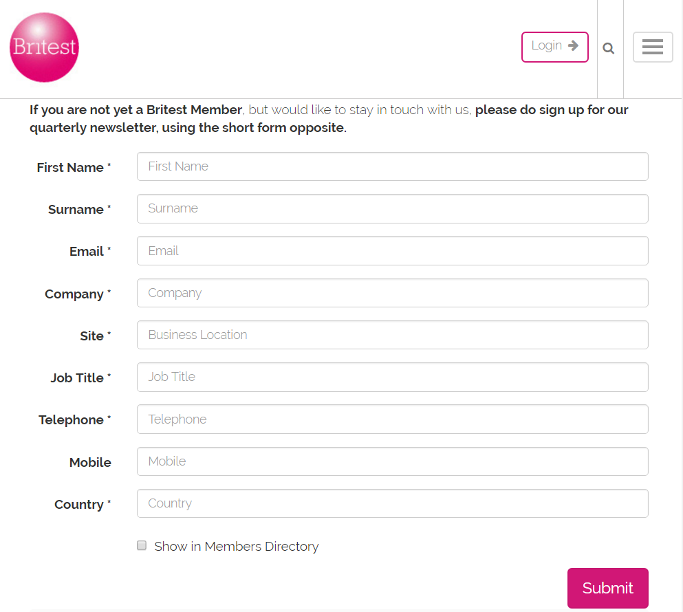
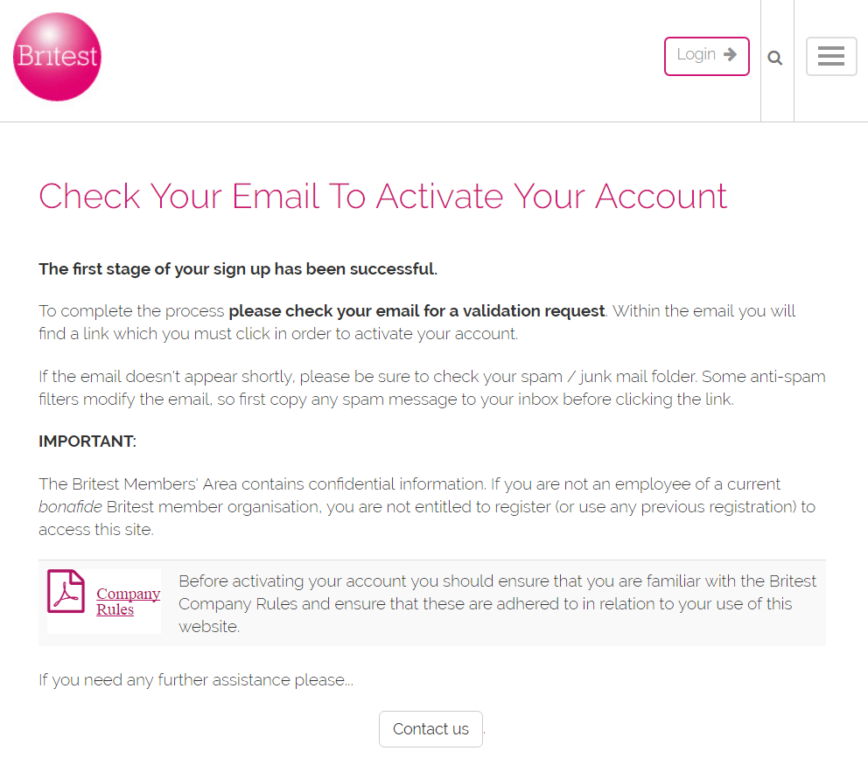
Registration::what
*Website name and design are not matching and are edited by the author

Slide 5
Registration::how

Slide 6
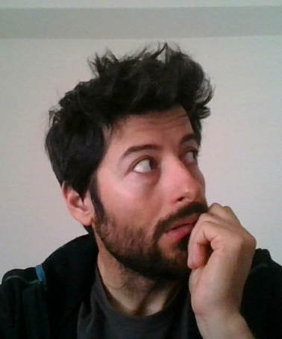
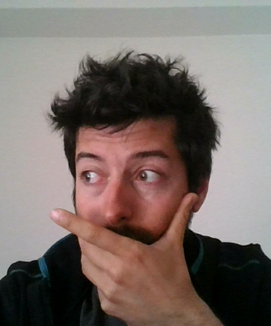
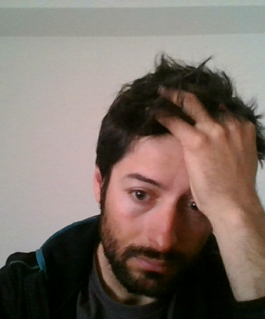
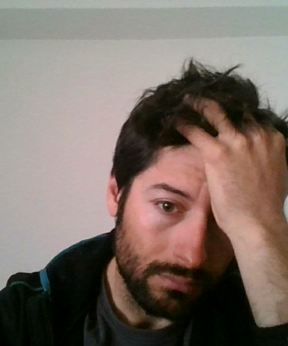
Registration::why
Forgot password

Slide 7
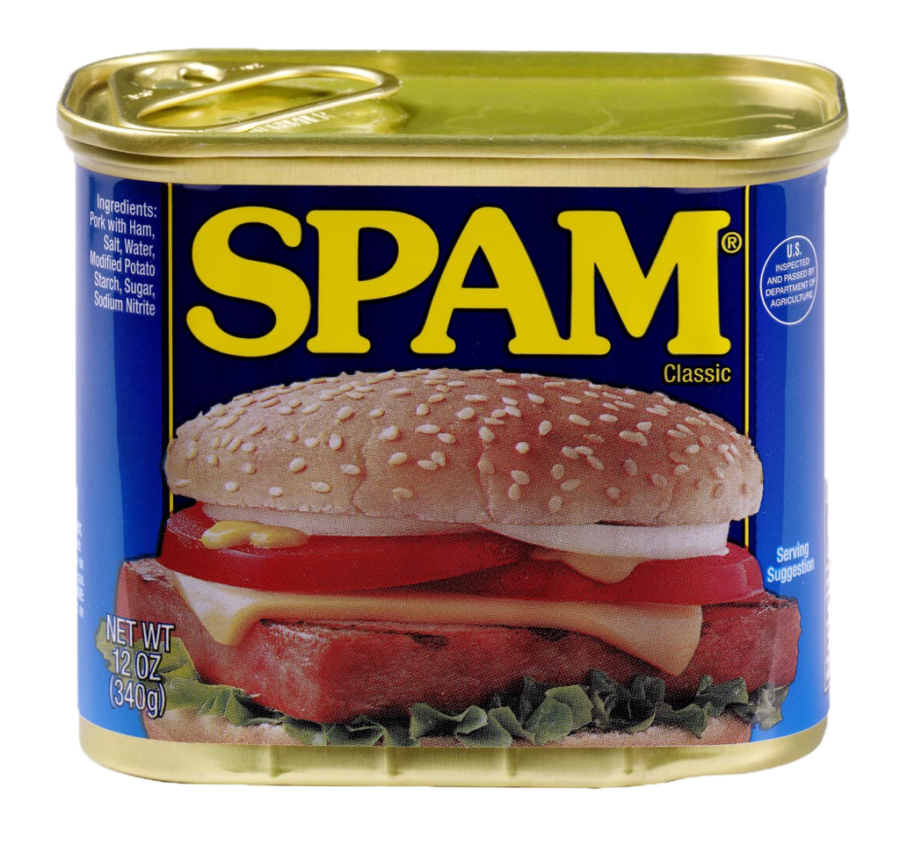
Enlarge your @#$%!#$#^%#$ in only 7 days
By Qwertyxp2000 - Own work, CC BY-SA 4.0, https://commons.wikimedia.org/w/index.php?curid=37340578

Slide 8
Storing password, plaintext
Username | Password
marjan.kindalov | marjan_srcka
jasna86 | Jasna&Milan4ever
Password too exposed

Slide 9
Hash?
https://mulpix.com/post/1021395473011807709.html

Slide 10
Cryptographic hash function
Algorithms:
MD5
SHA-0
SHA-1
SHA-2
SHA-3
BLAKE2
https://www.linkedin.com/pulse/2-steps-how-use-btc-blockchain-document-houman-goudarzi
Notes:
One – way

Slide 11
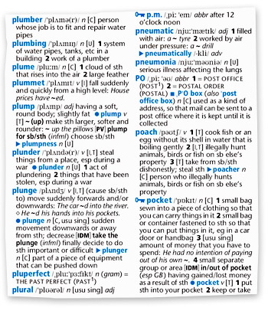
Storing password, hashed
Username | Hash(Password)
marjan.kindalov | 72ae25495a7981c40622d49f9a
jasna86 | 027bd9c8c8900d5c3d8456fa33
Input | Hash(input)
plumber | 72ae25495…
plumbing | fa5339a9b9…
plume | 54a9c5gdd4…
… | ….
Pre-computed Lookup Tables
Pre-computed Rainbow Tables
http://www.antimoon.com/learners/oxford-pocket.jpg
Notes:
Disclaimer: No hashes were calculated during the preparation of this presentation

Slide 12
Salt
SaltedPassword = Password + Salt
Calculate hash function on SaltedPassword
Efectivly longer password -> out of reach of precomputed lookup tables and similar

Slide 13
Storing password, salted
Salt = “Never Use A Static Salt”
Username | Hash(Salt+Password)
marjan.kindalov | 495a7981c40622d49f9a72ae25
jasna86 | c8c8900d5c3d8456fa33027bd9
Lookup Tables
Rainbow Tables

Slide 14
Storing password, dynamic salt
Username | Salt | Hash(Password+Salt)
marjan.kindalov | 0f048f59027bd9c8c8900d | 2ae25495a7981c40622d49f9a5
jasna86 | 6603abc670967e99c7e7f1 | 6603abc670967e99c7e7f1389e
Brute force attacks

Slide 15
Key stretching
100 000 hash/sec
10 000 iterations
10 password/sec
Notes:
Also Memory bound function
In cryptography, key stretching techniques are used to make a possibly weak key, typically a password or passphrase, more secure against a brute force attack by increasing the time it takes to test each possible key.

Slide 16
Storing password, key stretching
Username | Salt | Hash^10.000(Password+Salt)
marjan.kindalov | 0f048f59027bd9c8c8900d | 981c40622d49f9a52ae25495a7
jasna86 | 6603abc670967e99c7e7f1 | 9c7e7f1389e6603abc670967e9
Notes:
Also Memory bound function
In cryptography, key stretching techniques are used to make a possibly weak key, typically a password or passphrase, more secure against a brute force attack by increasing the time it takes to test each possible key.

Slide 17
Login page, user enumeration
User user = getUserFromDb(username);
If (user != null) {
hash = calculateHash(password, user.salt);
if (hash != user.hash) {
return “Invalid password”
}
} else {
return “Invalid user”
}
Notes:
Response codes, urls

Slide 18
Login page, user enumeration
User user = getUserFromDb(username);
If (user != null) {
hash = calculateHash(password, user.salt);
if (hash != user.hash) {
return “Invalid user/password”
}
} else {
return “Invalid user/password”
}

Slide 19
Login page, user enumeration
User user = getUserFromDb(username);
hash = calculateHash(password, user.salt);
If (user == null || hash != user.hash) {
return “Invalid user/password”
}

Slide 20
Login page, password enumeration
int loggingAttemptsInLast10Min =
getLoggingAttemptsAfter(username, now – 10min);
If (loggingAttemptsInLast10Min > 10) {
return “Too many attempts”
}
Username | AttemptTime
test1 | 2016-09-13T23:30:52.123Z
test2 | 2016-09-13T23:33:13.123Z
test1 | 2016-09-13T23:39:42.123Z

Slide 21
Java

Slide 23
Password Strength Quiz
length = 8
only lowercase letters = 26 chars
min one lowercase letter = 26 chars
min one capital letter = 26 chars
min one number = 10 chars
min one special char = 33 chars
Notes:
26 ^ 8 = 208827064576
Answer: >12754. During the presentation I stated 87 and I was WRONG. Thanks Atanas Todorovski for pointing that out.

Slide 24
Contact
Marjan Kindalov
Netcetera
mail: marjan.kindalov@gmail.com
Notes:
If you see this slide, I am happy to be alive

Slide 25
Resources
https://en.wikipedia.org/wiki/Cryptographic_nonce
https://en.wikipedia.org/wiki/Cryptographic_hash_function
https://en.wikipedia.org/wiki/Rainbow_table
https://en.wikipedia.org/wiki/Salt_(cryptography)
https://en.wikipedia.org/wiki/Key_stretching
https://en.wikipedia.org/wiki/Bcrypt
https://www.owasp.org/index.php/Authentication_Cheat_Sheet

