Slide 1
Building your own smarthome with openHAB Raspberry Pi and Arduino
(IoT)
Miki Jankov

Slide 2
About me
Java software engineer
4+ years of experience
Home automation hobbyist
Embedded system enthusiast
Started working with openHAB more than 2 years ago
Notes:
https://github.com/Mixajlo

Slide 3
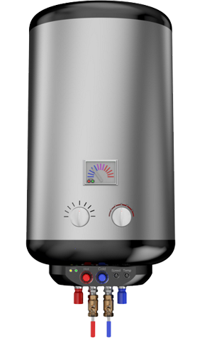
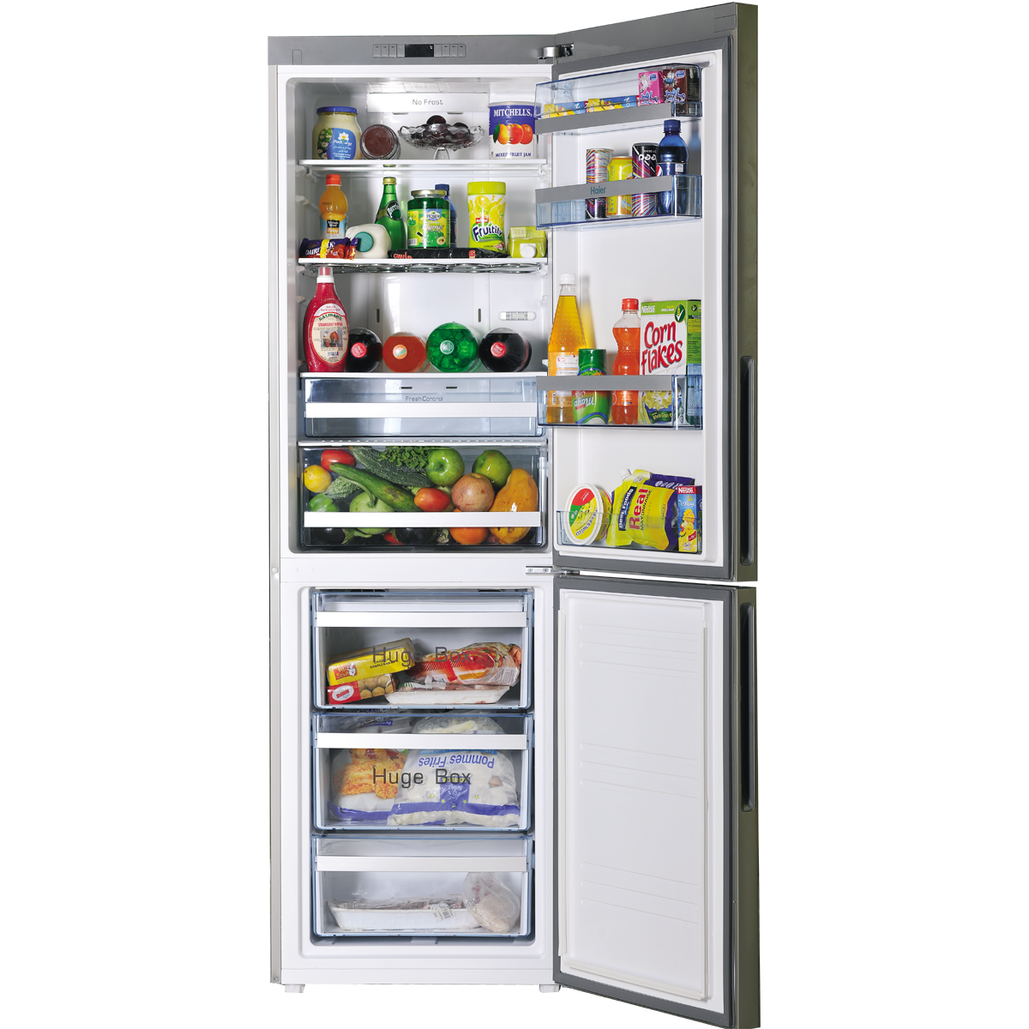
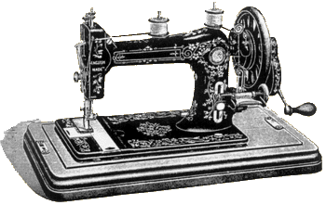
in the dawn of “smarthome”
(1829)
(1834)
(1889)
(1904)
(1920)

Slide 4
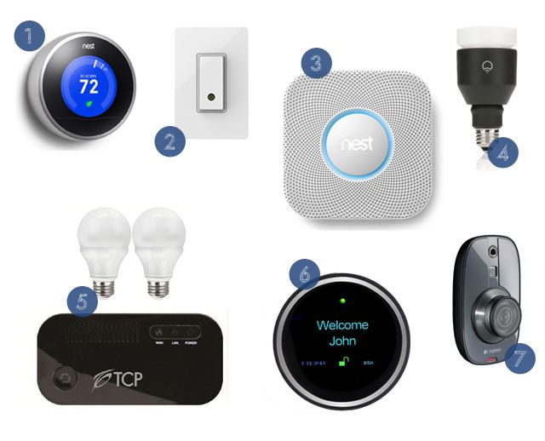
Modern “smarthome”

Slide 6
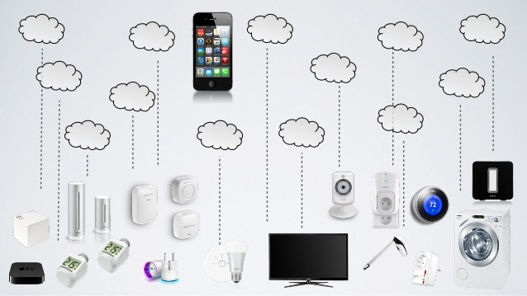
…or connected home

Slide 8
openhab
For personal use (2009)
Universal solution (Java)
Open source
Modular solution (OSGi)
Extending the software
Rule engine for automation
Eclipse smarthome framework
openHAB 2.0 (2017)
Kai Kreuzer

Slide 10
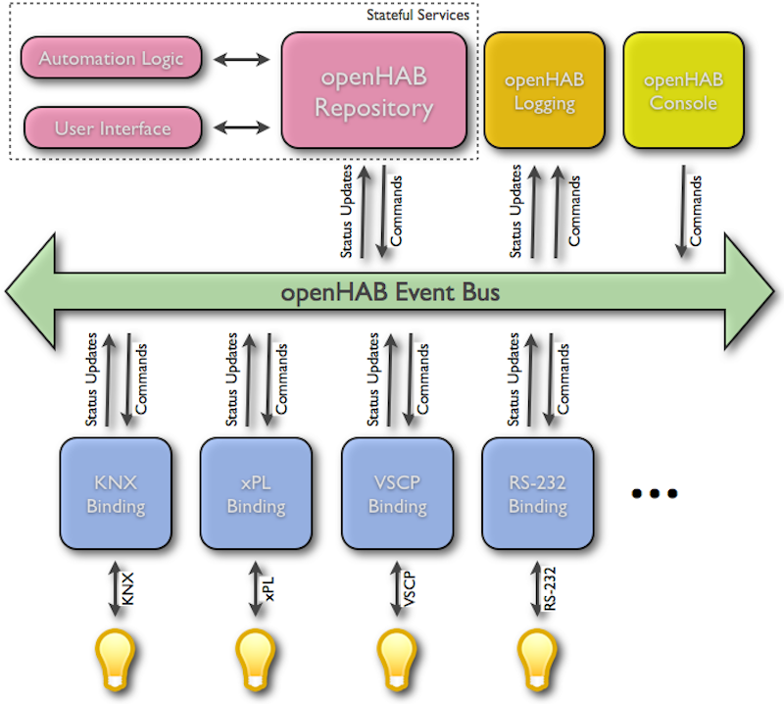
Architecture
Virtual view
Physical view

Slide 11
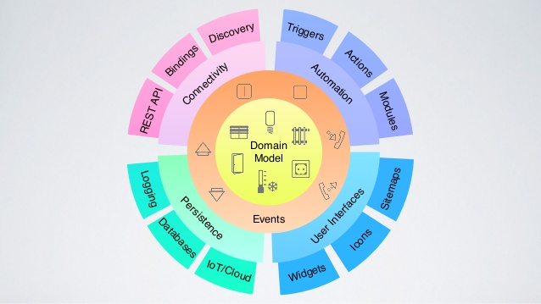
Architecture(2)

Slide 12
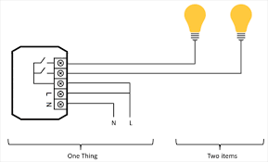
Concepts

Slide 13
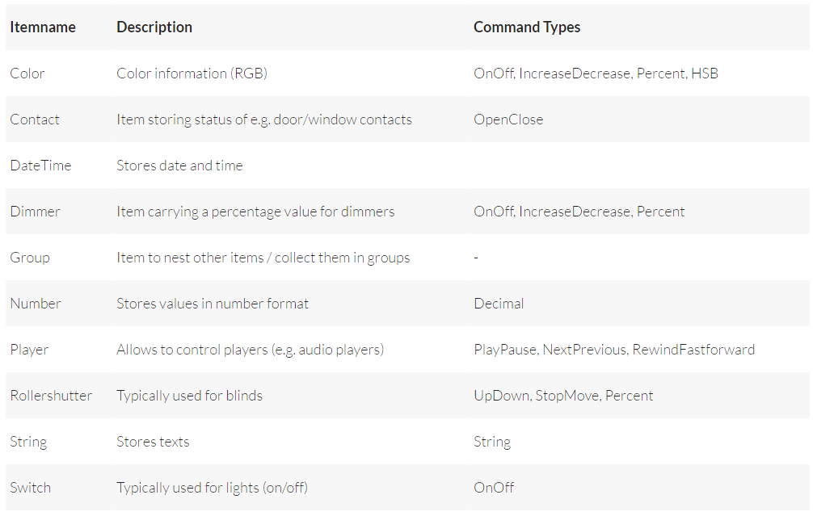
items

Slide 14
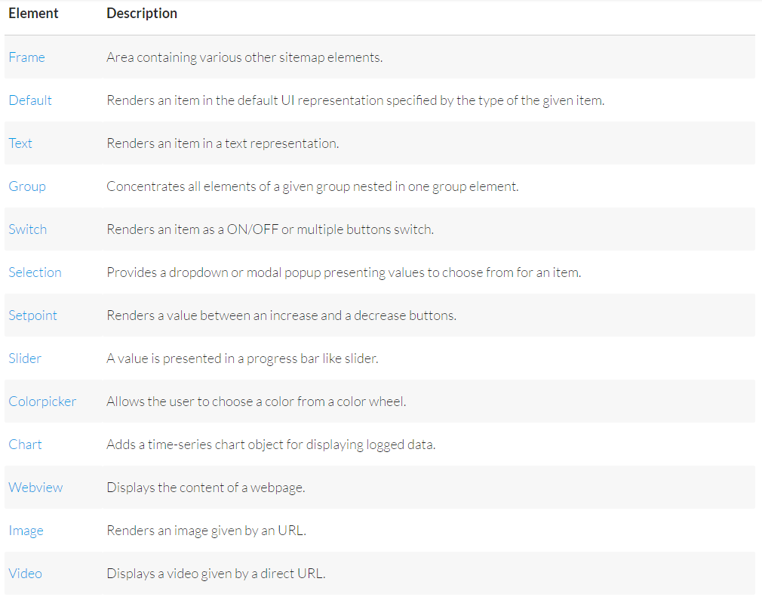
Sitemaps (UI)

Slide 15
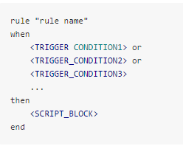
rules
Rule triggers
Event based
Time based
System based

Slide 16
Demo

Slide 17
Questions

